Slide 1
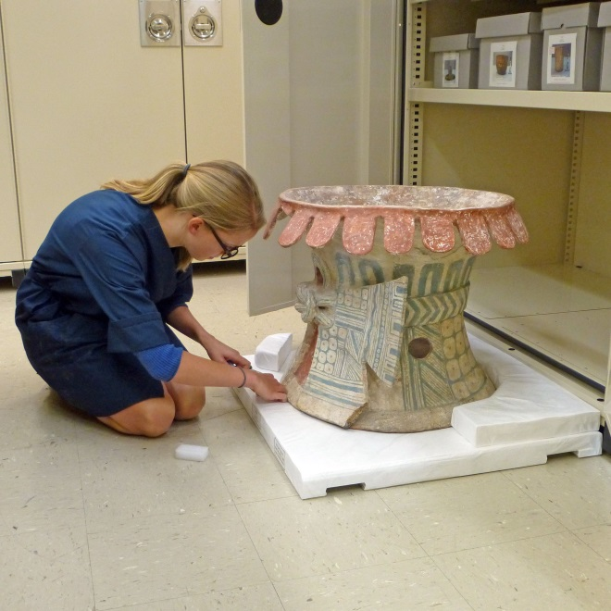
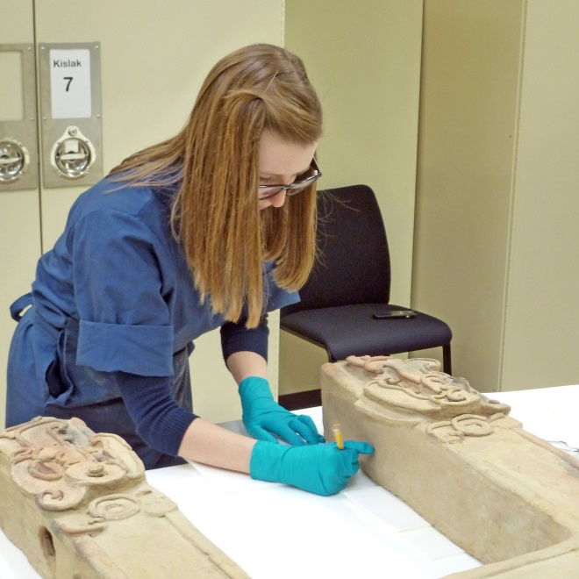
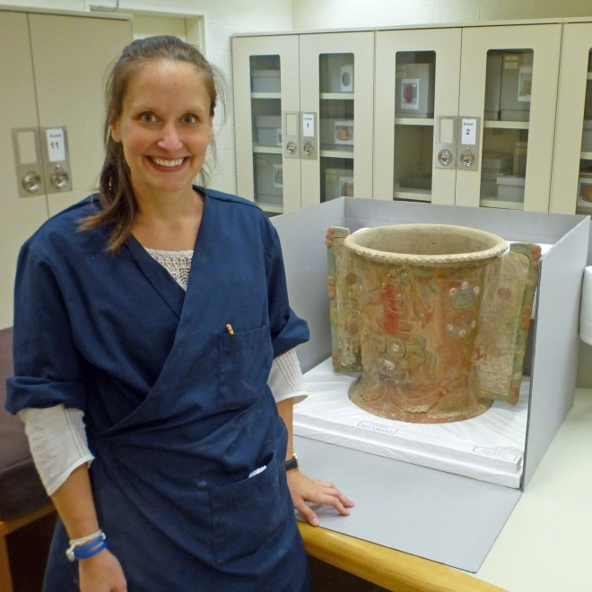

PRESERVATION HOUSING OF
LARGE, FRAGILE OBJECTS
Jim Thurn and Collections Stabilization Section at the Library of Congress
Notes:
The Collections Stabilization Section at the Library of Congress recently housed a group of large, fragile objects.
The pre-Columbian objects housed are from the Jay I. Kislak Collection.

Slide 2
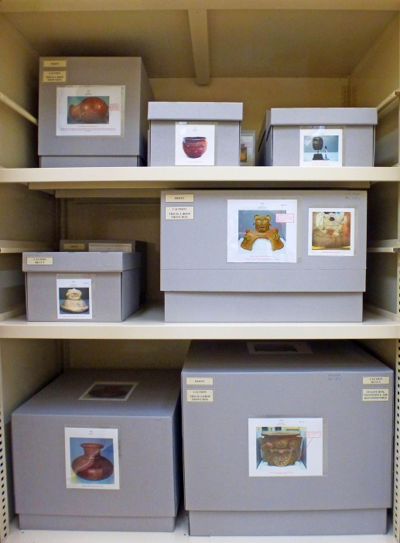
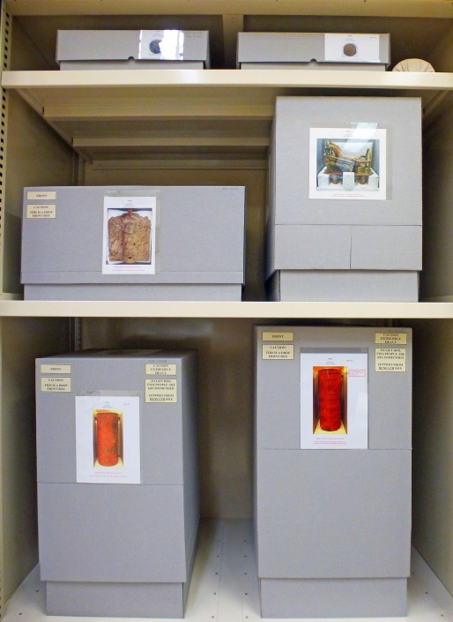
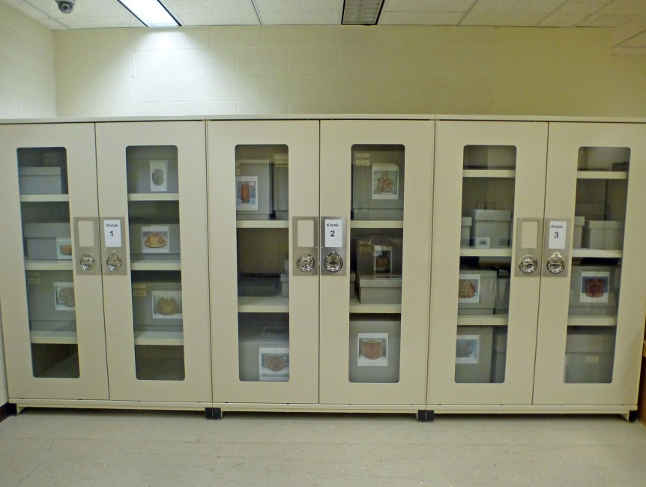
Purpose
Create protective enclosures for large, fragile objects.
Reduce direct handling of the objects, while still allowing viewing.
Minimize size requirement of enclosures to allow long-term storage in museum-quality cabinets.
Notes:
The enclosures reduce direct handling of the objects, and facilitate their viewing.
We make the enclosures as small as possible to conserve space at the Library, and allow long-term storage in museum-style cabinets.
Foam is added to protect the objects, but we avoid tightly-fitted furniture or cavities which can place objects at risk when they are removed or returned to the enclosures.

Slide 3
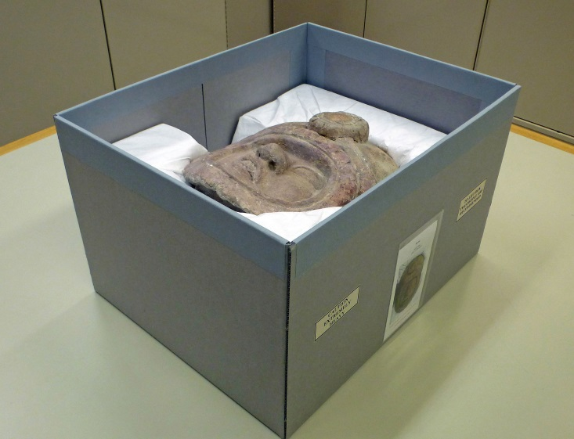
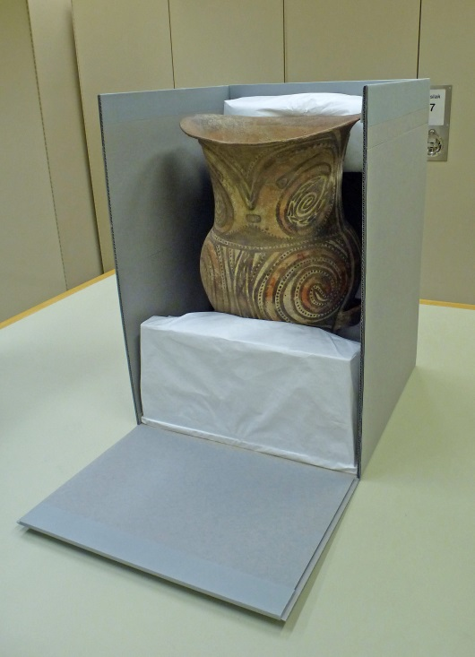
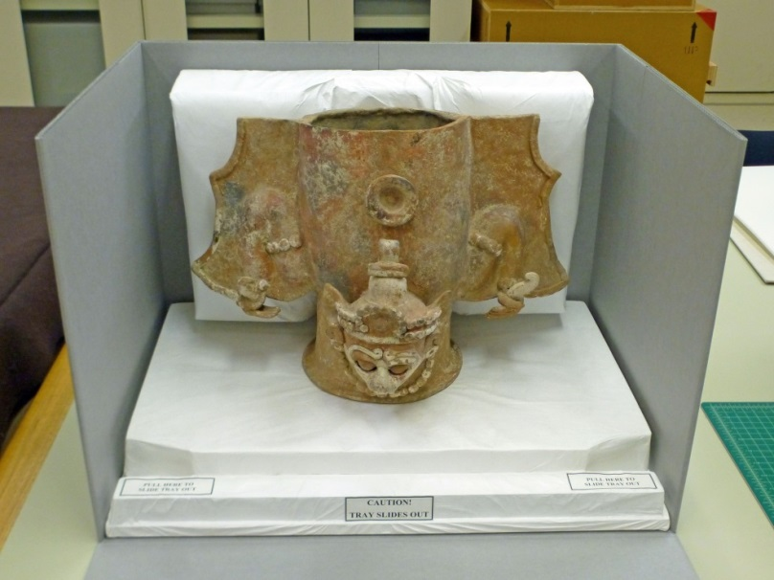
Description
Enclosures are made by hand
Archival materials
No PVAc necessary
Three general designs
Notes:
The B-flute boxes are custom made by hand, without PVAc.
We use three primary designs that are then tailored to the needs of specific objects.

Slide 4
Materials, Tools, and Supplies
Materials
B-flute, corrugated board
Binder board
40-point card stock
Honeycomb board (1/2”-thick)
Ethafoam planks (1”-thick)
Volara foam sheets (1/4”-thick)
Polyester batting
Tyvek sheeting
Book cloth for hinge reinforcement
Tools and Supplies
Ruler, tape measure
Utility knife
T-square
Scissors
Cutting mat
Lascaux adhesive for cloth hinge
Hot-melt glue applicator
Hot-melt glue (3M 3748 Q)
Cotton gloves (always wear during glue application to prevent burn injuries!)
Notes:
The materials, tools, and supplies are common to conservation labs and readily available.
Whenever hot-melt glue is applied, fabric gloves should be worn to prevent burn injuries.

Slide 5
Enclosure Options
Nest-type enclosure
  Simpler
  Suitable for symmetrical objects
Drop-front enclosure
  Best for tall, complex, and/or asymmetrical objects
  Optional U-shaped insert to protect front and sides of object
Drop-front enclosure with sliding tray
  Allows 360-degree viewing of object
  Optional U-shaped insert to protect front and sides of object
Notes:
The general design of an enclosure is chosen based on what is most protective of the object, and how the object will best be presented to viewers.
A nest-type enclosure is the simplest design, and most suitable for symmetrical objects.
A drop-front is best for tall objects such as vases, or asymmetrical objects.
A drop-front with a sliding tray allows the object to be slid out of the box and viewed from all sides.
A padded, U-shaped insert can be used with either type of drop-front enclosure to protect the front and sides of an object.

Slide 6
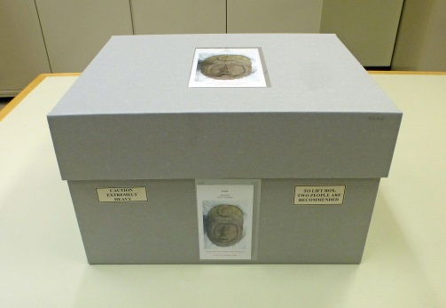
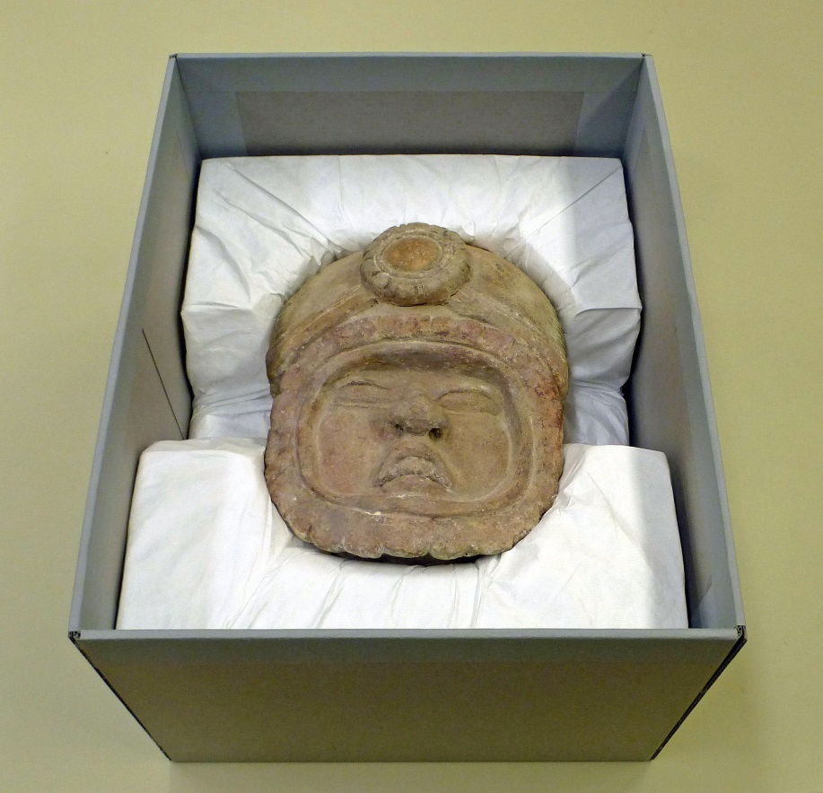

Construction
Nest-type enclosure
Notes:
This is a nest-type enclosure we made for the “Portrait Head of a Warrior.”
The piece is made of solid stone, and is especially heavy.

Slide 7
Construction
Nest-type enclosure: Box base
Folds Around to Back
3
2
2
Folds Around to Back
Back
(Folds Upward)
Fold 1 board thickness down
Fold 1 board thickness down
1
1
Side
(Folds Upward)
Base of Box
Side
(Folds Upward)
Folds Around to Side
Folds Around to Side
Fold 1 board thickness in
Fold 1 board thickness in
Front
(Folds Upward)
Fold
Cut
Fold Sequence
5
4
5
#
Notes:
We size the box by adding 3-1/2 inches to the height of the object, and 5 inches (2-1/2 inches per side) to the width and depth dimensions. This allows space for honeycomb board beneath the object, and foam beneath and to the sides.
The folding pattern creates double-thickness walls at the back and both sides.
Another B-flute board can be adhered to the inside of the front wall so all walls are double-thickness.
After folding, the board is trimmed if necessary, or fills of board are added to achieve a uniform two-board thickness on all walls.
The folds that are offset 1-board thickness allow space for the double-wall boards laminated together.
The sequence of folds allows the seams to be concealed on the interior of the box.

Slide 8
Construction
Nest-type enclosure: Box lid
½ inch added to depth of lid
Footprint of Lid
Footprint of Base of Box
½ inch added to width of lid
Notes:
The lid is constructed the same way as the box base, but ½-inch is added to the width and depth dimensions to prevent the lid from being too tight.
As a guideline, we make the lid height 1/3 to 1/2 the height of the box base.

Slide 9
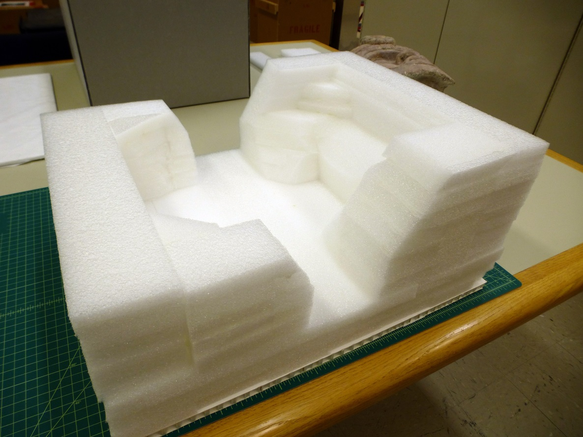
Construction
Nest-type enclosure
1 inch-thick Ethafoam planks
½ Honeycomb board
Notes:
Honeycomb board is cut to the interior dimensions of the box.
The nest is then built on top of the honeycomb board, adhering the foam to the board and to adjacent pieces of foam using hot-melt glue.
The inside of the nest is formed to follow the contours of the object as closely as possible to minimize pressure points, and to support the object securely.
Openings in the foam on both sides allow safe removal of the object.
The foam is covered with Tyvek, and the Tyvek is tucked between the foam and the walls of the enclosure.

Slide 10
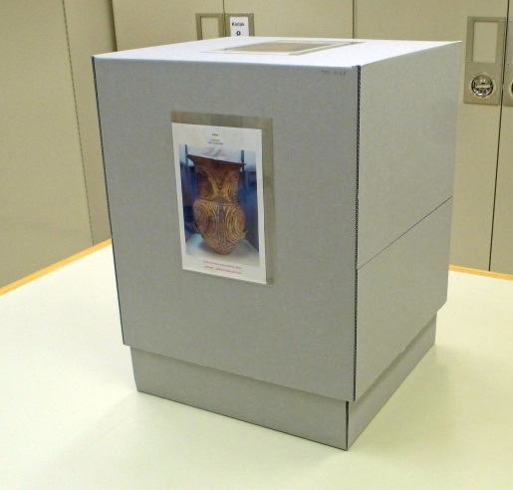
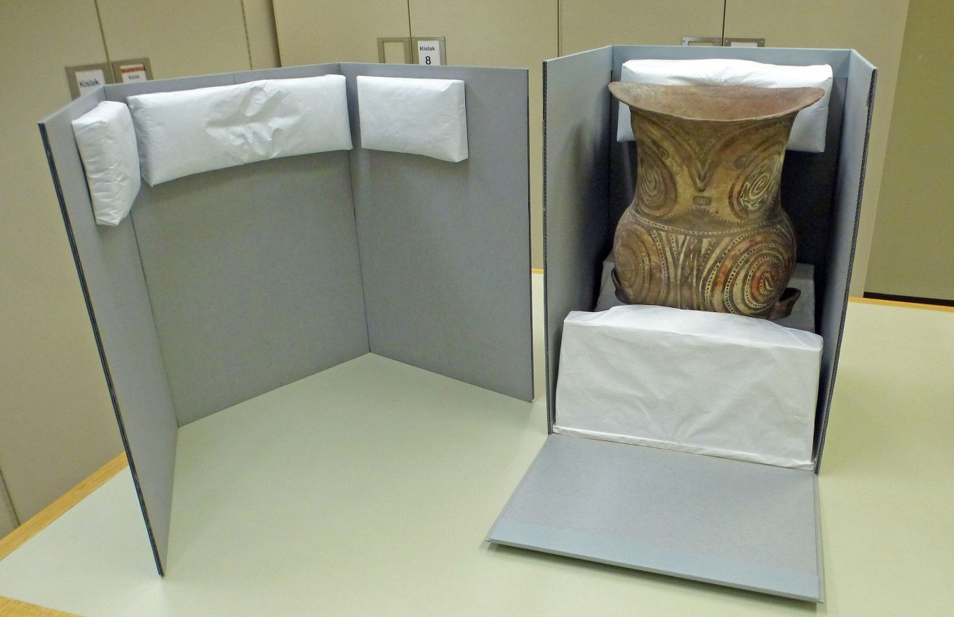
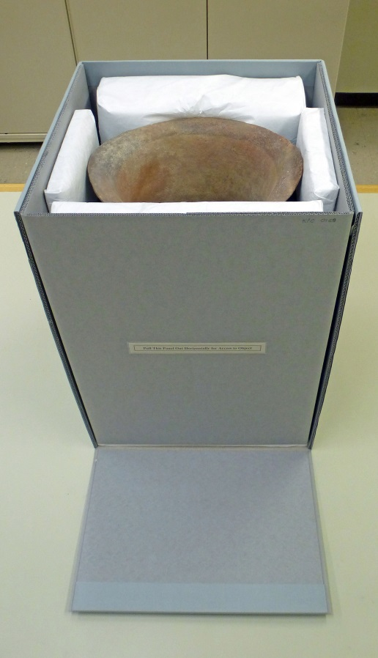
Construction
Drop-front enclosure
with removable, U-shaped insert
Notes:
This is a drop-front enclosure with a removable U-shaped insert.
The object is a large urn with a convex base.
Since the object is tall with some tipping potential, we thought it best not to make a removable tray.

Slide 11
Construction
Drop-front enclosure
with removable, U-shaped insert
Folds Around to Back
3
2
2
Folds Around to Back
Back
(Folds Upward)
Fold 1 board thickness down
Fold 1 board thickness down
1
1
Side
(Folds Upward)
Base of Box
Side
(Folds Upward)
Hinge reinforcement
Folds Around to Side
Folds Around to Side
Front
(Folds Upward)
Fold
Cut
Fold Sequence
4
5
4
#
Notes:
Book cloth can be used to reinforce the hinge of the drop front, and adhered with Lascaux adhesive.
The lid is made the same way as for the nest-type enclosure, except we make the lid height 85% of the base height for added rigidity and to cover gaps around the drop-front wall.

Slide 12
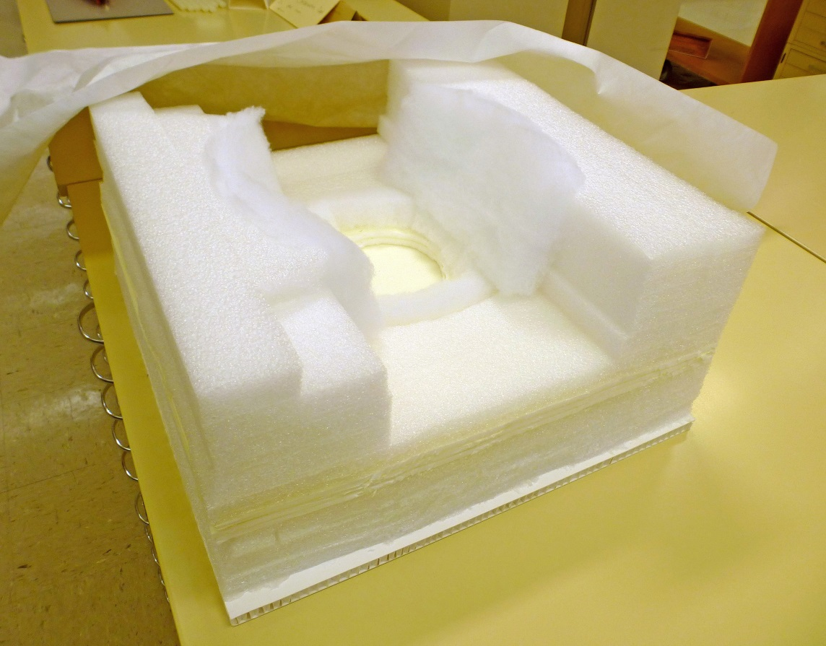
Construction
Drop-front enclosure
with removable, U-shaped insert
Tyvek sheeting
Polyester batting
¼ inch-thick Volara foam
1 inch-thick Ethafoam planks
½ inch-thick honeycomb board
Notes:
We build the support where the object will sit using foam, and polyester batting if appropriate, mimicking the contours of the object.

Slide 13
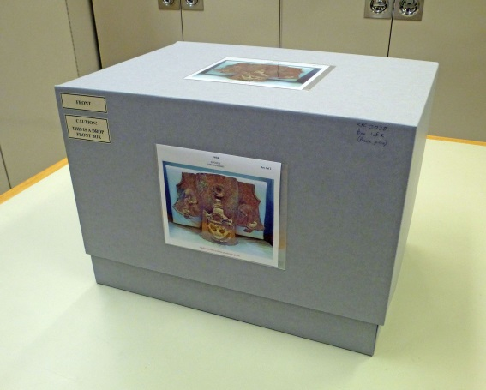
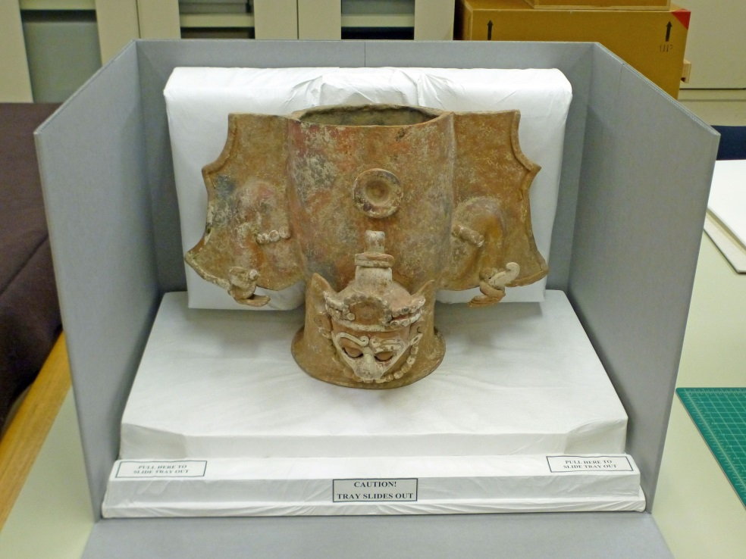
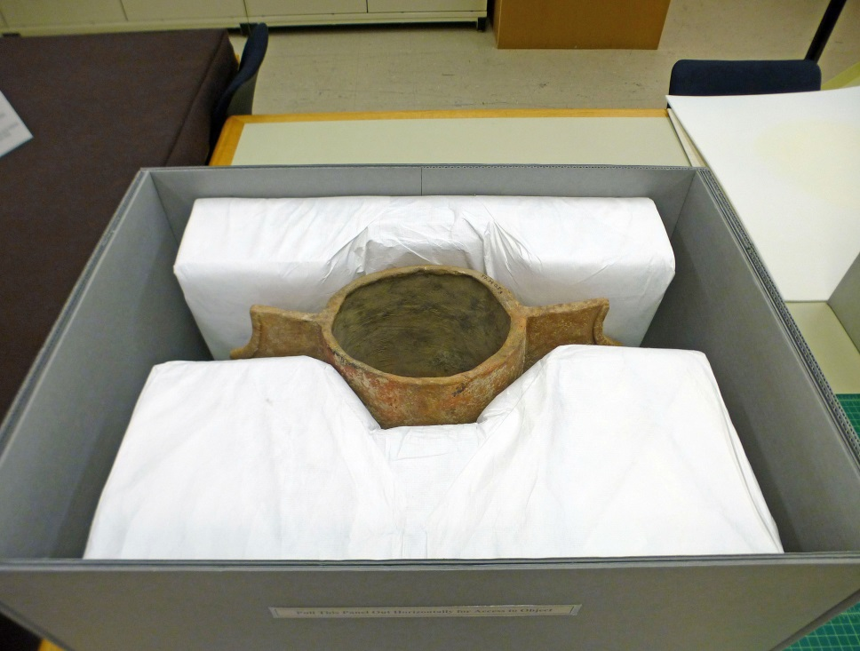
Construction
Drop-front enclosure with sliding tray and removable, U-shaped insert
Notes:
This is a drop-front enclosure with a sliding tray and removable, U-shaped insert.

Slide 14
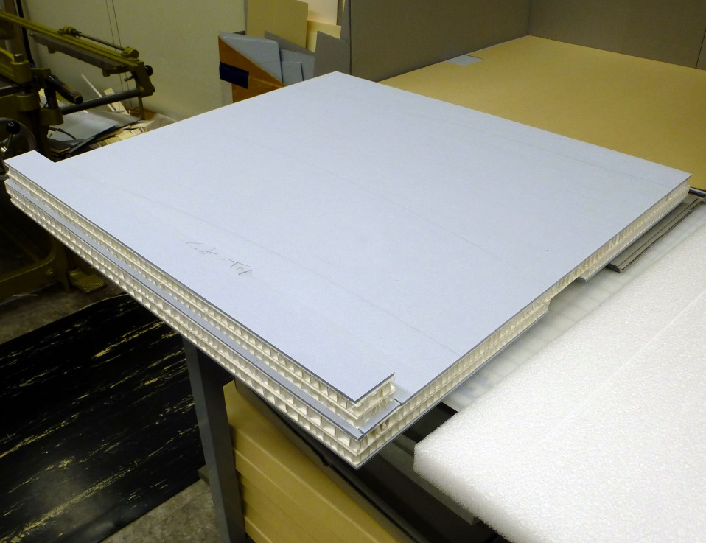
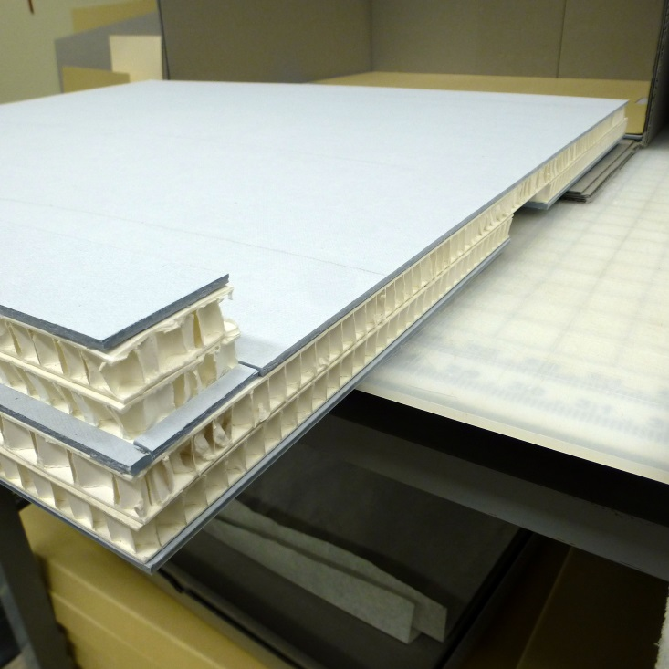
Construction
Drop-front enclosure with sliding tray and removable, U-shaped insert
Tray hand hold
Tray handle
Tray handle
Notes:
The tray is constructed of layers of honeycomb board for rigidity, and binder board for crush resistance.
The number of layers varies based on the size and weight of the object.
All layers are adhered using hot-melt glue.

Slide 15
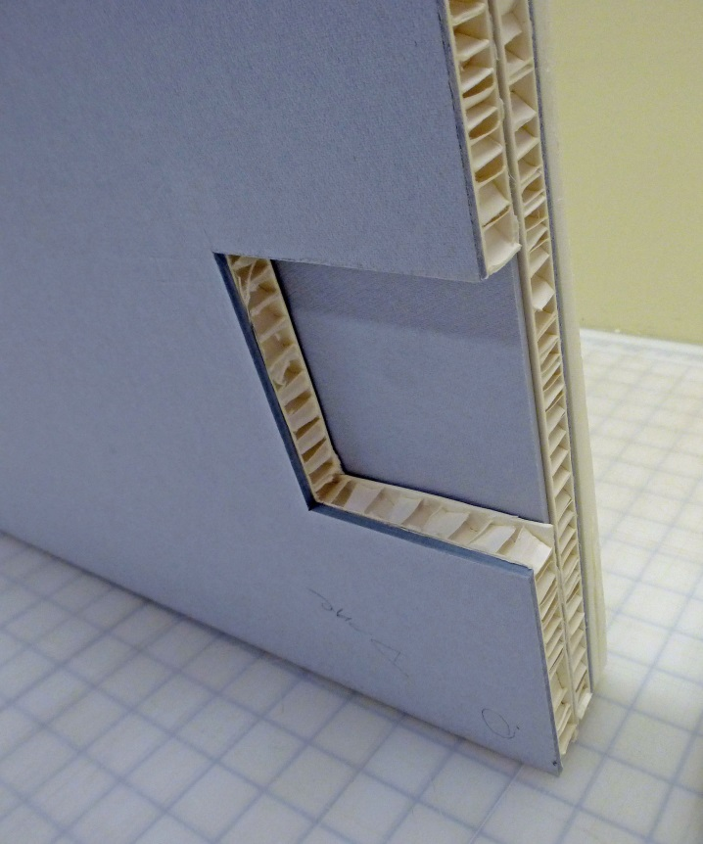
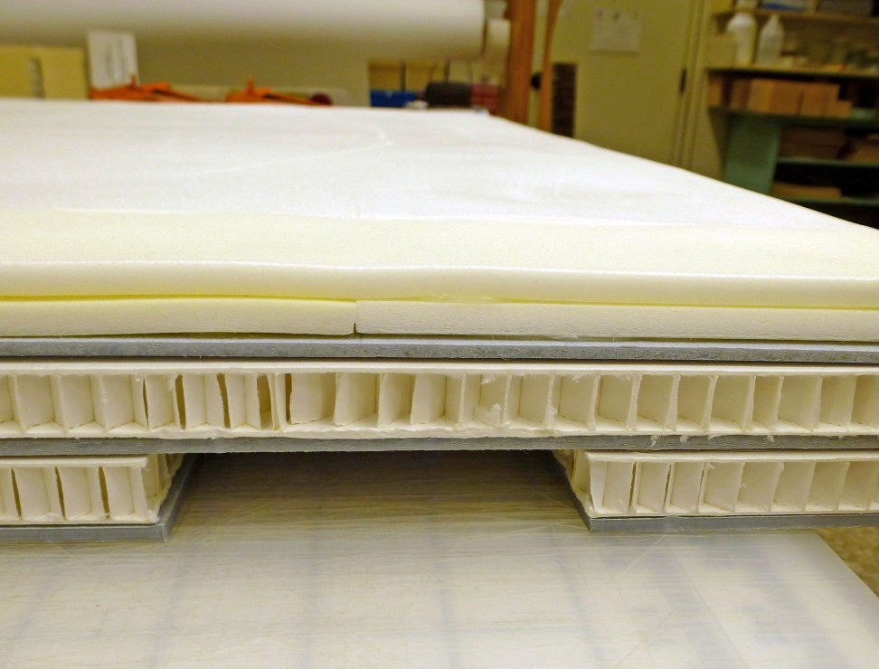
Construction
Drop-front enclosure with sliding tray and removable, U-shaped insert
Tray hand hold
(underside)
Tray hand hold
Notes:
This slide shows details of a hand hold on the underside of the tray.

Slide 16
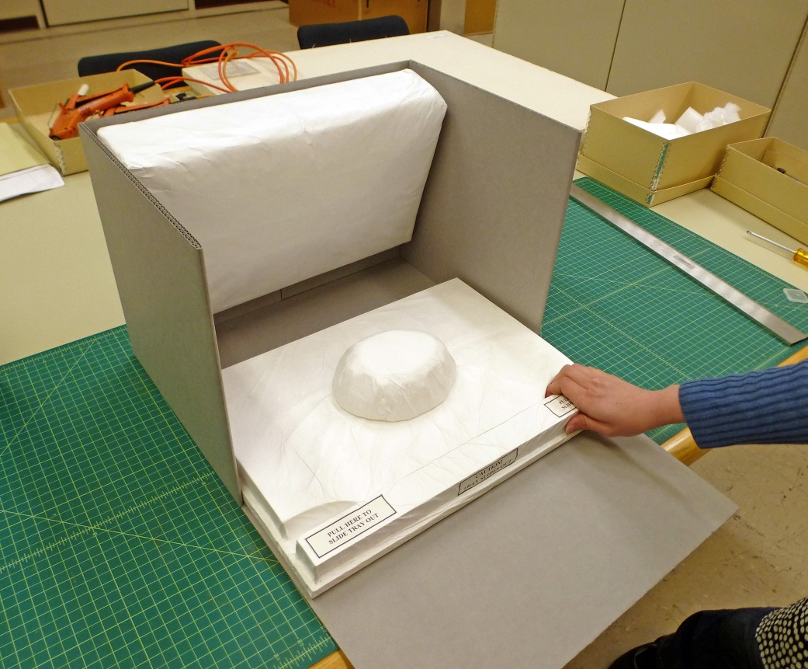
Construction
Drop-front enclosure with sliding tray and removable, U-shaped insert
Plug for hollow-base object
¼-inch space above honeycomb along both sides of foam and in front of handle to allow for U-shaped insert.
Tray handle
Notes:
A ¼-inch gap is provided along both sides and front of the tray to allow space for the U-shaped insert.
The Tyvek is adhered around the perimeter of the underside of the tray using hot-melt glue. The base of the tray is then covered with 40-point card stock to provide a smooth sliding surface and to prevent snagging of Tyvek.
For a hollow-base object, a foam plug covered in Tyvek is adhered to the tray to keep the object from shifting.

Slide 17
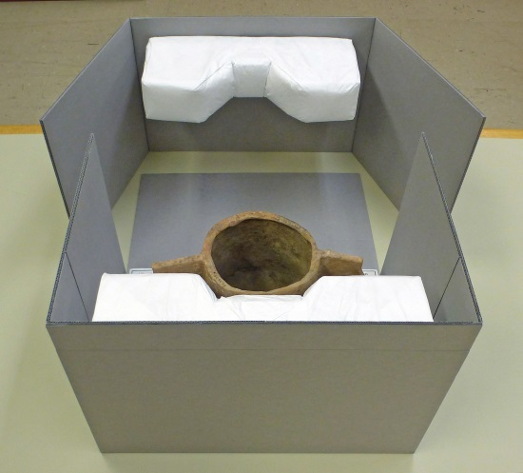
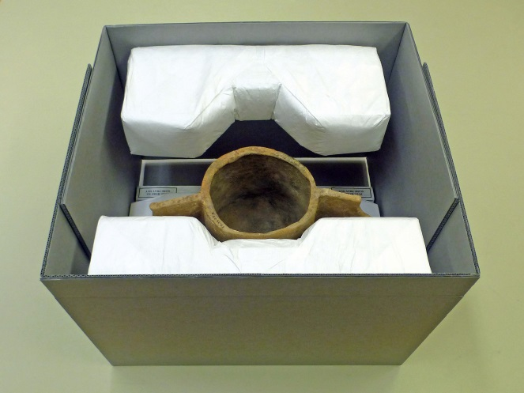
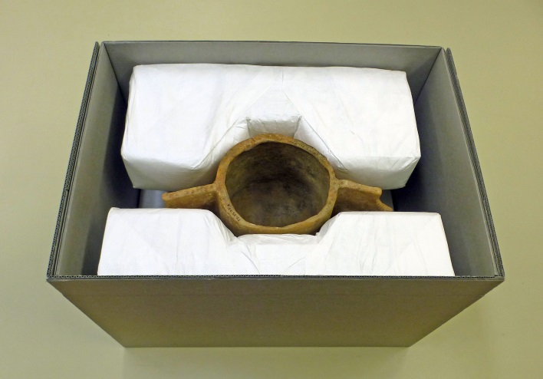
Construction
Drop-front enclosure with sliding tray and removable, U-shaped insert
Notes:
This slide shows the enclosure from behind, and the sequence of sliding the padded insert into place.
The insert is made of two layers of B-flute board, laminated together using hot-melt glue.
The pad is constructed of Ethafoam and polyester batting, covered with Tyvek.
Thank you.

